Slide 1


BIOLOGY FOR COMPUTER ENGINEERS - BBOC407
Module - 5
TRENDS IN BIOENGINEERING
By
Dr. Srividya R
Associate Professor, Dept of ISE

Slide 2

OVERVIEW
Muscular and Skeletal Systems as scaffolds, scaffolds and tissue engineering
Bioprinting techniques and materials
Electrical tongue and electrical nose in food science
DNA origami and Biocomputing
Bioimaging and Artificial Intelligence for disease diagnosis
Bioconcrete
Bioremediation
Biomining

Slide 3
Muscular and Skeletal Systems as scaffolds, scaffolds and tissue engineering
The musculoskeletal system (locomotor system) provides body with:
movement
stability
shape and
support.
It is subdivided into 2 broad systems:
Muscular system
Skeletal system

Slide 4
Muscular and Skeletal Systems as scaffolds, scaffolds and tissue engineering
1. Muscular system:
It includes all types of muscles in the body.
Skeletal muscles, act on the body joints, to produce movements.
It contains tendons which attach the muscles to bones.
2. Skeletal system:
It’s main component is the bone.
Bones articulate (join) with each other and form the joints.
They provide body with a hard-core, yet mobile, skeleton.
The function of the bones and joints are supported by cartilage, ligaments, and bursae.

Slide 5
Continued...
Therefore its main function is to provide the body with stability and mobility.
The musculoskeletal system has many other functions:
The skeletal part plays an important role in other homeostatic functions such as
storage of minerals (e.g., calcium) and
hematopoiesis (blood cell production process)
2. The muscular system stores most of the body's carbohydrates in the form of glycogen.

Slide 6
Continued...
Mechanism:
The nervous system controls voluntary muscle movements.
Voluntary muscles are ones that are controled intentionally.
Movements happen when:
The nervous system sends message to activate voluntary muscles.
Muscle fibers contract (tense up) in response to the message.
When the muscle activates or bunches up, it pulls on the tendon (Tendons attach muscles to bones).
The tendon pulls the bone, making it move.
To relax the muscle, nervous system sends another message.
It triggers the muscles to relax or deactivate.
The relaxed muscle releases tension, moving the bone to a resting position.

Slide 7
Continued...
Hundreds of conditions can cause problems with the musculoskeletal system.
They can affect the way you move, speak and interact with the world.
Some of the most common causes of musculoskeletal pain and movement problems are:
•Aging
•Arthritis
•Back problems
•Cancer
•Congenital abnormalities
•Injuries
•Osteoporosis
•Muscular dystrophy

Slide 8

BIO-ENGINEERING SOLUTIONS FOR MUSCULAR DYSTROPHY AND OSTEOPOROSIS
One of the most common musculoskeletal conditions is Osteoporosis.
Arthritis is also very common.
Muscular dystrophy is a group of diseases that cause progressive weakness and loss of muscle mass
Awareness is increasing that :
Osteoporosis is a major complication of Duchenne muscular dystrophy (DMD) and
Its treatment, requires monitoring for early diagnosis and intervention to prevent clinically important sequelae.

Slide 9

Continued...
The traditional method of fabricating 3D muscle constructs first developed more than 25 years ago.
It involves casting myogenic cells within a cylindrically shaped collagen-I gel.
In this system, cell-mediated gel, compaction and remodeling result in generation of passive stress within the gel.
This, promotes the fusion of myoblasts (muscle cells) into myotubes(multinucleated cells chain) and myotube alignment.
Alternatively, myoblasts can be cultured on laminin- or hydrogel-coated dishes.
Till myotubes assemble into a cylindrical tissue construct & are attached at the ends to premade suture anchors.

Slide 10
Continued...
Cell alignment within 3D constructs increases fusion efficiency.
In addition to collagen I, different natural hydrogels and their derivatives can support 3D growth and fusion of myogenic cells.
Hydrogels have been dominant muscle-engineering scaffold (provide structural support for cell attachment and tissue development),
Also, studies of muscle repair have mainly utilized:
acellular natural scaffolds
porous matrices made of degradable polymeric materials or
scaffold-free myoblast sheets.

Slide 11

DNA origami and Biocomputing
DNA origami is the nanoscale folding of DNA to create arbitrary 2-D and 3-D shapes at the nanoscale.
The current method of DNA origami was developed by Paul Rothemund at the California Institute of Technology.
The process involves folding of a long single strand of viral DNA aided by multiple smaller "staple" strands.
These shorter strands bind the longer in various places, resulting in the formation of a pre-defined 2-D or 3-D shape.
Examples: a smiley face and a coarse map of China and the America, and many 3-D structures such as cubes.

Slide 12

Continued...
To produce a desired shape, images are drawn with a raster fill of a single long DNA molecule.
This design is then fed into a computer program that calculates the placement of individual staple strands.
Each staple binds to a specific region of the DNA template.
The DNA is mixed, then heated and cooled.
As the DNA cools, the various staples pull the long strand into the desired shape.

Slide 13
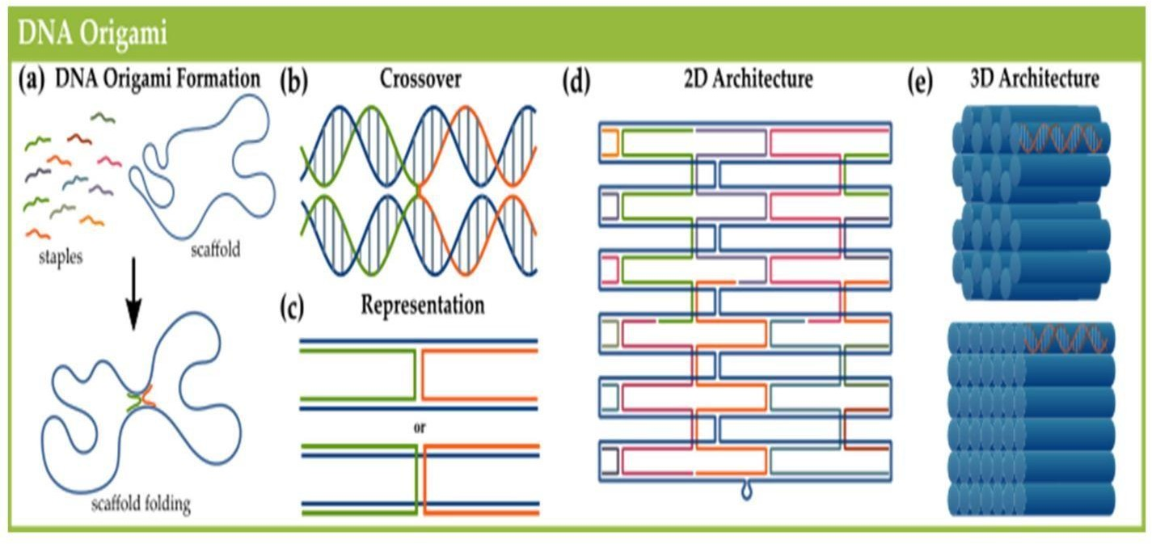
DNA origami

Slide 14

Continued...
Designs are observable via several methods, including:
Electron microscopy.
Atomic force microscopy, or fluorescence microscopy when DNA is coupled to fluorescent materials
Bottom-up self-assembly methods are considered as alternatives.
It offers cheap, parallel synthesis of nanostructures under relatively mild conditions.
Software was developed to assist this process using CAD software.
Ex: caDNAno is an open source software for creating such structures from DNA.
The use of software has increased the ease of the process & drastically reduced the errors made by manual calculations.

Slide 15

Continued...
Applications:
Many potential applications, include:
enzyme immobilization.
drug delivery systems and
nanotechnological self-assembly of materials.
DNA is not the natural choice for building active structures for nanorobotic applications, due to its lack of structural and catalytic versatility
Several papers suggest the possibility of molecular walkers on origami and switches for algorithmic computing.

Slide 16
Continued...
Following is application conducted in laboratories with clinical potential.
Long strands of DNA are folded into a complex scaffold of staple strands having 200–300 nucleotides.
This lead to formation of a complex structure with nanoscale dimensions.
These are in their preliminary developmental stages.
Theoretically, DNA origami has potential to contribute in diagnosis and drug delivery areas.
Cancer therapy and diagnosis is one such potential domain where DNA origami showed significant anticancer efficacy.

Slide 17
BioComputing
A computer that uses components of biological origin (like molecules of DNA) instead of electrical components.
To understand & model, healthy or sick human body, researchers and doctors are utilizing more & more tools and techniques.
This trend is pushing for a new field called Biomedical Computing which is a frontier among:
signal processing,
pattern recognition,
optimization,
nonlinear dynamics,
computer science and biology,
chemistry and medicine.

Slide 18
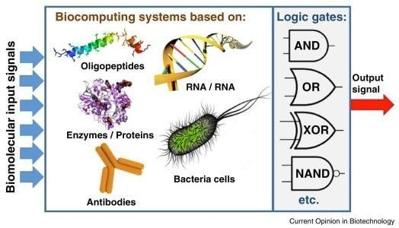
Continued...
Computing process use synthesized biological components to store and manipulate data.
The result is small, faster computing processes that operates with great accuracy.
The main application is in disease prediction and disease diagnosis.

Slide 19
Bioimaging and Artificial Intelligence for disease diagnosis
Bioimaging is a noninvasive process of visualizing biological activity in a specific period.
It does not inhibit the various life processes such as movement, respiration, etc.,
It helps:
To report the 3D structure of specimens apart from inferencing physically.
In connecting the observation of subcellular structures and all the tissues in multicellular organisms.
Scientists to analyze molecules, cells and tissues.
Bioimaging spans:
Observation of subcellular structures and
Entire cells over tissues up to entire multicellular organisms.

Slide 20
Bioimaging and Artificial Intelligence for disease diagnosis
Nanoparticle fluorescence imaging helps in
gene detection,
protein analysis,
enzyme activity evaluation,
element tracing,
cell tracking,
early stage disease diagnosis,
tumor related research, and
monitoring real time therapeutic effects.
Bioimaging uses light, fluorescence, electrons, ultrasound, X-ray, magnetic resonance and positrons as sources for imaging

Slide 21
Artificial Intelligence for disease diagnosis
AI can assist providers in a variety of patient care and intelligent health systems.
AI techniques are prevalent for disease diagnosis, drug discovery, and patient risk identification.
Detecting and forestalling spread of ailments require ongoing data and examination.
AI in health care aid in gathering and processing valuable data to programming surgeon robots.
AI describes the capability of a machine to study the way a human learns.
AI in healthcare alters how information gets composed, analysed, and developed for patient care.

Slide 22
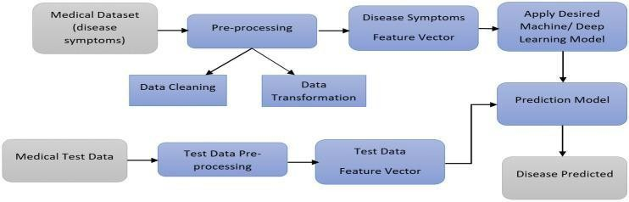
Artificial Intelligence for disease diagnosis
System planning is the fundamental design of the system.
It includes framework’s views, the course of action of framework.
Real-world information requires pre-preparing.
Information pre-preparing takes the crude information, cycles it, eliminates errors, and spares it an extra examination.
Information experiences a progression of steps during pre-handling (information cleaning).

Slide 23
Artificial Intelligence for disease diagnosis
In information osmosis, the information is joined from a combination of sources.
The information is then amended for any blend of mistakes, and they are quickly taken care of.
Information Alteration: Data in this progression is standardized.
Information standardization can be executed utilizing several ways.
Information is then mutual and developed.

Slide 24
Bioconcrete
Bio-concrete is a self-healing form of concrete designed to repair its own cracks.
To heal cracks in the concrete, Jonkers chose bacteria, that produce limestone (CaCO3 precipitation) on a biological basis.
The positive side-effect is:
the bacteria consumed oxygen, which in turn prevents internal corrosion of reinforced concrete
This bacteria do not pose a risk, since they can only survive under alkaline conditions inside concrete.
Jonkers and his team of researchers developed 3 different bacterial concrete mixtures:
self-healing concrete, repair mortar and a liquid repair system.

Slide 25
Continued...
The repair mortar and liquid system: used when acute damage has occurred on concrete elements.
In self-healing concrete: bacterial content is integrated during construction & is complex.
Bacterial spores are encapsulated within 2-to 4-millimeter wide clay pellets.
Then added to the cement mix with separate nitrogen, phosphorous and a nutrient agent.
This approach ensures that bacteria remains dormant in concrete for up to 200 years.
Contact with nutrients occurs only if water penetrates into a crack – and not while mixing cement.
Thus, the need for expensive and complex manual repairs is eliminated.

Slide 26
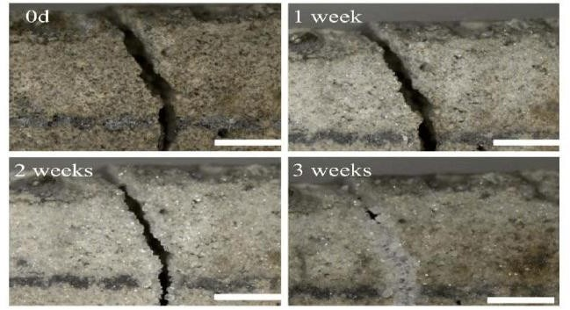
Bioconcrete

Slide 27
Bio remediation
Bioremediation is a biotechnical process.
It is a type of waste management technique which involves use of organisms to remove or utilize the pollutants from a polluted area.
Bioremediation is of 3 types :
1)Biostimulation
2)Bioaugmentation
3)Intrinsic Bioremediation

Slide 28
Continued...
Biostimulation:
As the name suggests, bacteria is stimulated to initiate the process.
The contaminated soil is first mixed with special nutrients substances.
It stimulates growth of microbes, resulting in efficient and quick removal of contaminants.
Bioaugmentation:
At times, microorganisms are required to extract the contaminants.
For example – municipal waste water.
In these cases, the process of bioaugmentation is used.
One major drawback:
It almost becomes impossible to control growth of microorganisms in the process of removing contaminant.

Slide 29

Continued...
Intrinsic Bioremediation:
It is most effective in soil and water because these always have a high probability of being contaminated.
It is mostly used in underground places like underground petroleum tanks.
In such place,
It is difficult to detect a leakage and
Contaminants and toxins enter through the leaks and contaminate the petrol.
Thus, only microorganisms can remove the toxins and clean the tanks.
Microorganisms are utilized here because of their ability to degrade pollutants via biochemical pathways.

Slide 30
Continued...
Immobilization of microbial cells and enzymes by adsorption is done through their physical interaction with surface of water-insoluble carriers.
This method, is quick, simple, eco-friendly and cost-effective.
Bioremediation helps to:
clean up water sources,
create healthier soil, and
improve air quality around the globe.
But Excavation-based remediation processes, can be disruptive.

Slide 31
Biomining
Biomining is the process of using microorganisms (microbes) to extract metals of economic interest
Biomining techniques may also be used to clean up sites that have been polluted with metals.
Valuable metals are commonly found in solid minerals.
Microbes can oxidize metals, allowing them to dissolve in water.
This is the basic process behind most biomining.
Another, biomining technique uses microbes to break down the surrounding minerals.
This makes it easier to recover the metal of interest directly from the remaining rock.
Most current biomining operations target valuable metals like:
copper, uranium, nickel, and gold, commonly found in sulfidic (sulfur-bearing) minerals.

Slide 32
Continued...
Other metals, like gold, are not directly dissolved by this microbial process, but minerals surrounding these metals are dissolved.
When the metal of interest is directly dissolved, the biomining process is called “bioleaching”
When the metal of interest is made more accessible or “enriched” in the material left behind, it is called “biooxidation”
Both processes involve microbial reactions with necessary nutrients, like oxygen, occur together.
Biohydrometallurgy is a natural processes of interactions between microbes and minerals.

Slide 33
Continued...
It extracts valuable metals from a low-grade ore with the help of microorganisms such as bacteria or archaea.
A) Heavy metal ions absorption process:
--- The metal ions of waste water adhere to surface of nanoporous adsorbents.
--- The adsorption process could be selective for one or more metals than others.
--- The regeneration process could be achieved using a desorbing agent.
B) Various modification techniques (i.e., nitrogenation, oxidation, and sulfuration):
--- Are used to functionalize carbon with different functional groups.
--- Functionalization enhances adsorption capacity and stability.

Slide 34
Bioprinting techniques and materials
  Bio printing is defined as the printing of structures consisting of living cells, bio materials and active bio molecules
  A solution for the organ shortages
  Significant potential of drug delivery & cancer studies
  Controllable microstructures with a high degree of reproducibility and scalability
1
2
3

Slide 35
Bio Ink Materials
Protein based bio-ink
Synthetic polymers
Decellularized ECM
Hydro gel based bio-inks

Slide 36
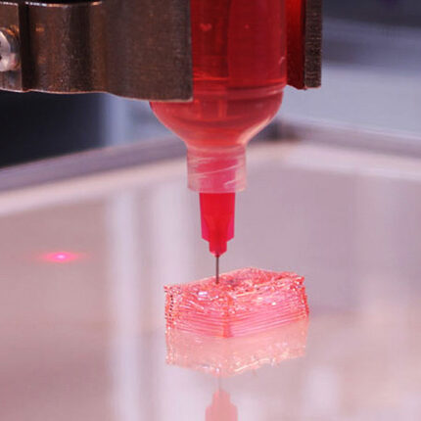
Hydrogels
Hydrogels are attractive materials for bio printing.
They are enormous three dimensional network of polymer chains holding a mass of water

Slide 37
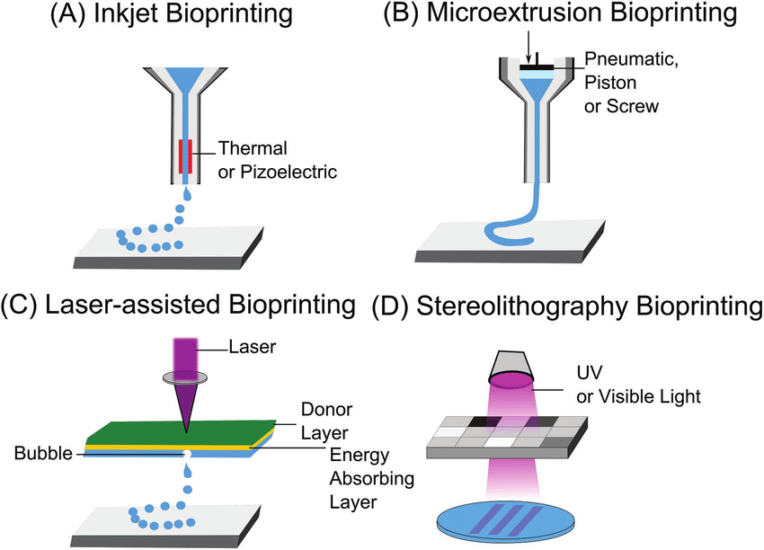
Types
-

Slide 38
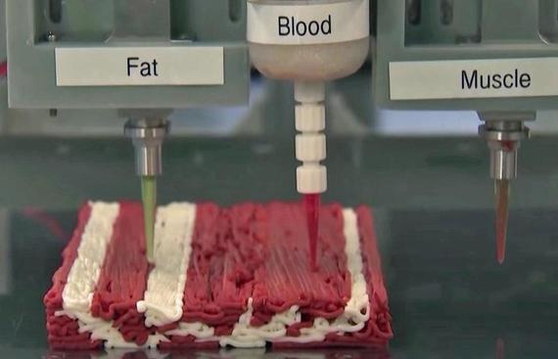
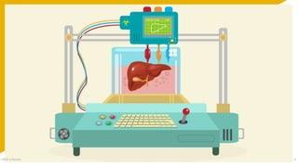
3D Printed Organs

Slide 39
Electrical tongue and electrical nose in food science
An Electrical Nose/Tongue is a DEVICE Intended to Detect ODORS/FLAVORS respectively..
"electronic sensing" or “e- sensing”
capability of reproducing human senses using sensor arrays and pattern recognition systems
Since 1982, research has been developing technologies, commonly referred to as electronic noses.

Slide 40
Continued...
WHAT IS AN ELECTRONIC NOSE ?
❖ E-noses have a series of sensors that correspond to components of an odor and analyzes its chemical makeup to identify it.
❖ They are much more sensitive than human noses as they have a greater number of receptor sensors with higher sensitivity.
❖ Our human nose is elegant, sensitive, and self-repairing, but the E-nose sensors do not fatigue or get the "flu".
❖ Further, the E-nose can be sent to detect toxic and otherwise hazardous situations that humans may wish to avoid.

Slide 41
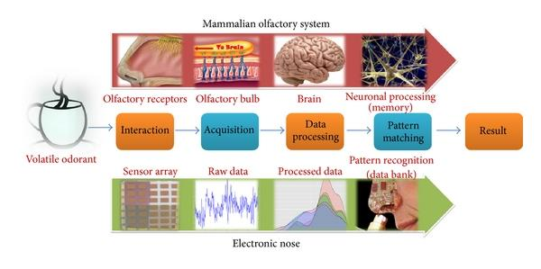
Continued...
The stages of the recognition process are similar to human olfaction and are performed for:
❖ Interaction with the smell
❖ Sample acquisition
❖ Data Processing
❖ Pattern Matching
❖ Data storage and retrieval

Slide 42
Continued...
E-NOSE DEVICES FOR EVALUATING THE AROMA AND FLAVOR CHARACTERISTICS OF WINES AND FOOD GRAINS
2 important uses of e-nose are for analyzing wines and food grains.
1) They are used for the classification and quality assurance of wines.
Sensory and chemical properties of wine, especially color, aroma, and taste, are important aspects of their quality.
2) The aroma of grains is the primary criterion of fitness for consumption in many countries.

Slide 43
Continued...
The E-Nose devices are used in these Industries:
Agricultural
Petrochemical
Chemical
Food and beverage
Packaging materials
Plastics
Pet food
Pulp and paper
Medical research
Military

Slide 44
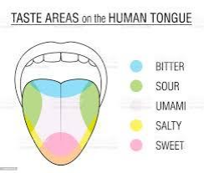
Electronic tongue
The electronic tongue is an instrument that measures and compares tastes.
Chemical compounds responsible for taste are detected by human taste buds and the 7 sensors of electronic instruments detect the same dissolved organic and inorganic compounds.
The types of taste that is generated is divided into five categories:
Sourness
Saltiness
Bitterness
Sweetness
Umami (savoriness)

Slide 45
Electronic tongue
❖ Tastants, chemicals in foods, are detected by taste buds, which consist of special sensory cells.
❖When stimulated, these cells send signals to specific areas of the brain, which make us conscious of the perception of taste.
Electronic tongues have several applications in various industrial areas: the pharmaceutical industry, food and beverage sector, etc. for:
1) Analyze flavor ageing in beverages (fruit juice, alcoholic or non-alcoholic drinks, flavored milks)
2) Quantify bitterness or “spicy level” of drinks or dissolved compounds
3) Quantify taste masking efficiency of formulations (tablets, syrups, powders, capsules, lozenges, etc.)
4) Analyze medicines stability in terms of taste
5) Benchmark target products
6) Monitor environmental parameters
7) Monitor biological and biochemical processes

Slide 46
THANK YOU

